Slide 1
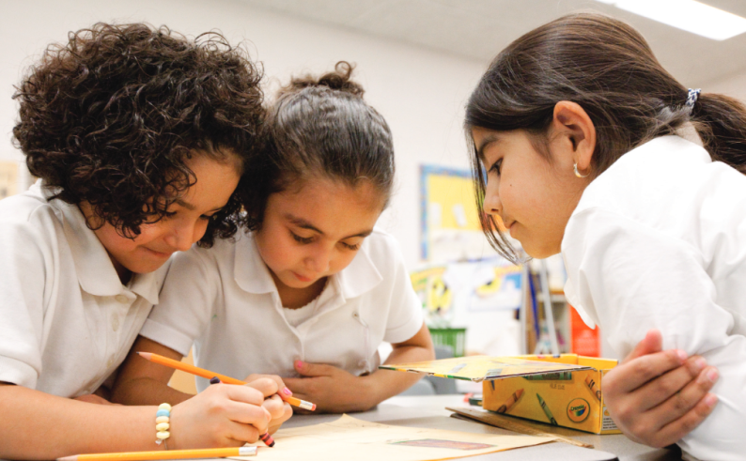
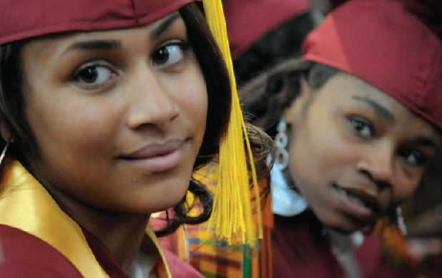
How have educational outcomes in Chicago Public Schools changed over time?
Elaine Allensworth

Slide 2

Chicago has many of the challenges of other urban cities and school districts
Achievement is considerably lower than in more affluent districts
Large disparities in educational attainment by race, ethnicity and gender
Considerable school segregation by race, income and student achievement level
Declining enrollment, with fiscal implications
Budget instability
Notes:
Chicago has many of the challenges we see across large cities that come with having areas of concentrated poverty and racial segregation, gun violence that is likely increasing exposure to trauma and chronic stress in families in many communities. This past decade has certainly brought a number of extra stresses to Chicago’s schools, with leadership transitions and state budget crises.
It’s easy to focus on all of the challenges because we really want to fix them. But if you only focus on the challenges you lose sight of what is working. Paul & Sean showed that test scores have improved, and are stronger than the gains in many other places. Ultimately, we hope that test score gains lead to better educational attainment, and represent a stronger school experience where students are more engaged in learning and excited about school.

Slide 3
Educational attainment has been rising in Chicago
Notes:
Ten years ago, even students who started high school with strong test scores in Chicago were at risk of failing courses in the ninth grade.
*In 2006 only 61% of freshman finished the year on-track to graduate on time. That means almost 40% of students failed at least one full-year course in their first year of high school so they didn’t have the credits they needed to be likely to graduate on time. Ten years later, in 2016, the district had a FOT of 88%. This is a leading indicator of high school graduation—so we expect graduation rates to continue to grow, at least until 2020 when the freshmen in 2016 would graduate.

Slide 4
Educational attainment has been rising in Chicago
Notes:
Improvements in high school graduation rates tend to follow improvements in ontrack rates by 4 years, as students need four years to move from ninth graders to graduates. But over the last 10 years, we’ve seen graduation rates rise 17 percentage points, from 2006 to 2016. These improvements have been driven by non-charter, non-selective schools. Many neighborhood high schools have shown dramatic improvements in graduation rates.

Slide 5
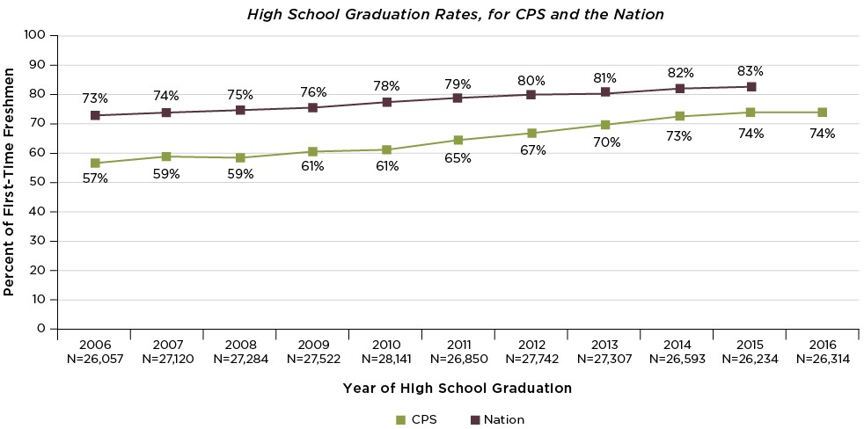
Graduation rates in Chicago have risen faster than the nation
Half of “non-graduates” are now students with alternative diplomas, GEDs, or students still enrolled in high school
Notes:
Graduation rates have been increasing across the country. Faster growth in Chicago than the nation overall.
The improvements have not always been equitable. Graduation rates improved first among white and Asian students—who started out with higher graduation rates, then Latino students, and started improving last with African American students who started out furthest behind—so at first equity got worse as graduation rates improved. In the most recent years, though, the groups that showed the biggest improvements have been Black and Latino young men—which were the groups that were furthest behind—so we have now been seeing improvements in equity while overall graduation rates continue to rise.
Sometimes people are afraid that students who dropped out are miscoded as transfers. But transfer rates haven’t changed that much, and even declined in a number of the years with the most growth in graduation rates. That doesn’t explain the improvements.
There also are concerns that students are increasingly graduating from alternative schools, instead of regular ones—alternative schools meet the state of IL grad requirements, but not necessarily CPS requirements, which are much harder. The rates shown here are calculated by the Consortium, and we only include regular diplomas, not diplomas from alternative schools, so that is not part of the explanation here. We count alternative school diplomas and GEDs as non-graduates—part of the 26% not graduating in four years.
In 2006, the vast majority of nongraduates were dropouts. In recent years, half of the non-graduates have actually been alternative school/GED recipients or students still in school—which is a big change. Actual dropout rates are a third of what they once were, as a larger percentage of students counted as nongraduates actually are students who get some type of credential.

Slide 6
Educational attainment has been rising in Chicago
Notes:
Returning again to this figure. Sometimes I hear people worry that if schools start graduating more students, the quality of the diploma will decline. So let’s look at college outcomes to see if students are still as likely to go to college as they were in the past.

Slide 7
Educational attainment has been rising in Chicago
Notes:
Many more students are graduating high school, and among those graduates, a larger percentage are enrolling in college than in the past. Among CPS graduates, 2-year college enrollment rates have increased by three percentage points, and 4-year college enrollment rates have increased by 11 percentage points, to 44% of graduates. These are rates of immediate college enrollment upon graduating. The four-year college enrollment rate is on-par with the national average, even though CPS is an 85% low-income district and we know finances play a major part in college enrollment.

Slide 8
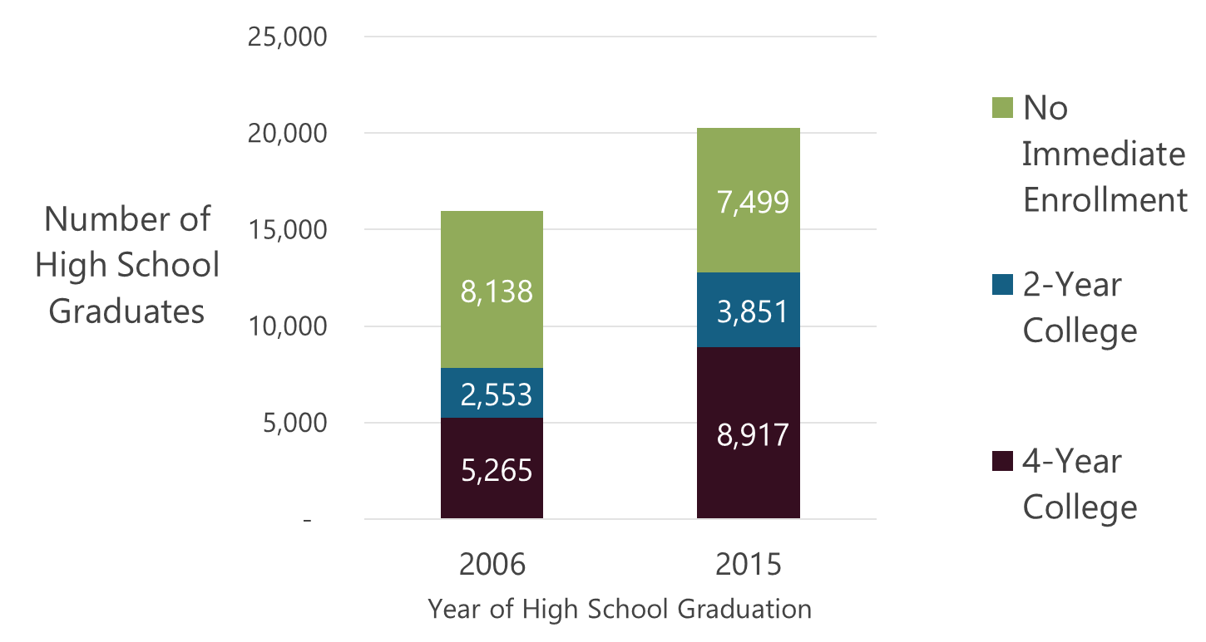
Many more students are enrolling in college immediately after high school
37%
51%
63%
12,768
49%
7,818
Notes:
It used to be more students did not enroll in college immediately after high school than did. Now graduates are much more likely to enroll in college immediately after high school than not enroll in college, by almost 2-1. Because hs graduation rates have increased, there are many more students who could potentially enroll in an extra 4,000-some students in 2016 than in 2006. So its an increase on top of an increase. Now 5,000 more students are enrolling in college immediately after high school each year.

Slide 9
Educational attainment has been rising in Chicago
Notes:
Many more students are graduating high school and entering college, and those students who go to college are actually slightly more likely to graduate than they were in the past. So there are gains on top of gains. Each of these steps accumulate on the other. I should note, that while there have been improvements in postsecondary outcomes among all racial-ethnic groups, and among both boys and girls, the increases have been larger among girls than among boys. So rates are up for all students, but there is more inequity in outcomes by gender.
These increases in postsecondary outcomes correspond with higher academic achievement among graduates.

Slide 10
Graduates have higher academic achievement than in the past
Notes:
Pass rates on AP exams are also up, while more students are taking multiple AP classes.
Many more students are making it to the end of 11th grade to take the ACT (SAT). About 5,000 more students more students took the ACT in 2016 than in 2006, and their scores were about one and a half points higher
There is no better indicator of how students will do in college than their high school GPA—it used to be only a fifth of students graduated with a B average or better, now it’s almost a third. Let’s look at GPAs a little closer…

Slide 11
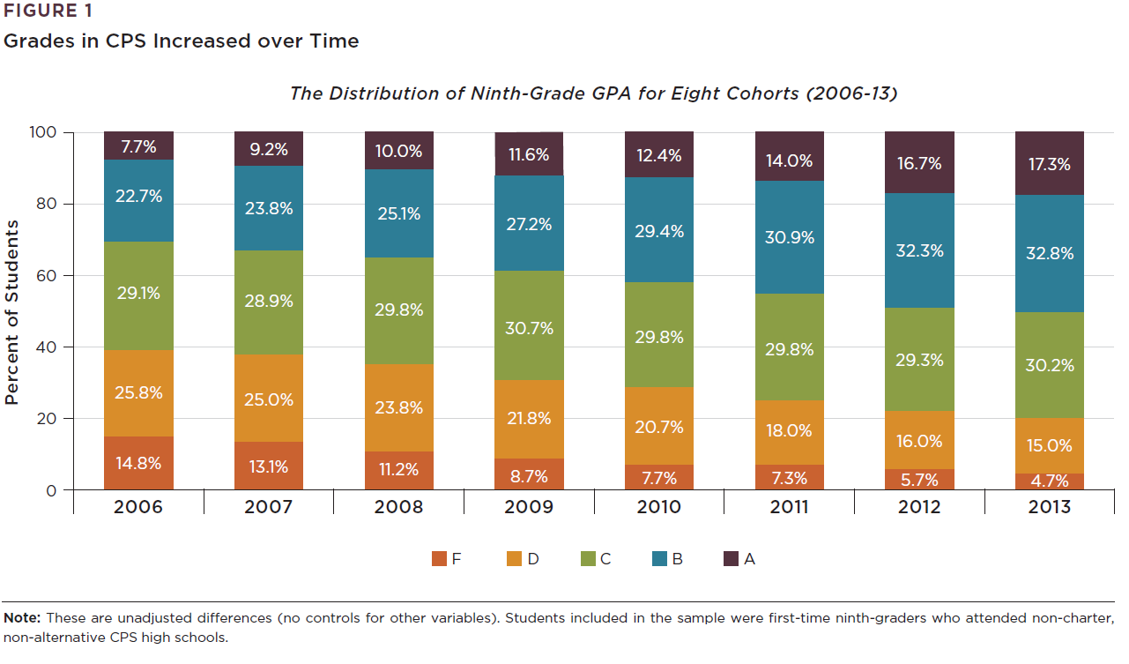
Fewer students are failing classes, more students are earning As & Bs
Notes:
Let’s look at the grades the last few cohorts of graduates received when they were freshmen. I noted at the beginning of this presentation that many students—even students with strong test scores in the middle grades—used to fail classes when they came to high school. In 2006, 40 percent of students ended their 9th grade with D average or below. Over time, that has been cut in half, while many more students are engaged at levels that allow them to earn Bs or better.
Why? There have been demographic and economic changes in the district. These don’t really account for much of the improvements—the changes haven’t been large enough to have more than modest influence. In recent years, students have been entering high school with higher middle grade achievement, and that explains some of the recent improvements in high schools. But this chart represents improvements that were happening in high schools before the elementary schools started to improve. High schools have been increasingly successful with students, compared to students with similar entering achievement and backgrounds who started high school in prior years. It suggests the high schools are doing a better job supporting students to do high school work.

Slide 12
Students and teachers are reporting better classroom experiences
Safety at school
Clarity of instruction
Academic press and rigor
Personalized attention from teachers
Engagement in classes
Trust among teachers and between students and teachers
Attendance has been increasing
Suspension rates have declined
Notes:
In fact, both students and teachers have been reporting better school climate in the districtwide 5Essentials school climate surveys, in elementary and high schools.
Not all areas of the survey reports have been improving. But we see some of the most consistent improvements in the measures that directly touch students, and we see corresponding reports from the perspectives of both students and teachers.
In addition, attendance has been increasing—first there were improvements in attendance in the high schools, and in recent years we’ve seen improvements in elementary grades. Suspension rates are down. We have so many metrics of how the schools are doing, and the fact that all of them are up suggests these gains are real, and they are really substantial.

Slide 13

Chicago has shown that change is possible
Notes:
We know that CPS has struggled with declining enrollment, state budget impasse, many years of leadership turnover. At the same time, this is a district that is really innovative, which has been at the forefront of some national movements in educational change, doing intentional work around restorative justice and SEL, freshman ontrack, college and FASFA tracking, instructional improvement, collaboration within schools, and different types of learning networks across schools.
This is a school system with a dedicated network of support in the larger community, through nonprofits and foundations.
Chicago’s improvements are happening despite all of the challenges that have been occurring, which personally—speaking for myself--makes me think we many truly courageous, devoted professionals in our schools. This is a district that has shown remarkable improvements in the educational outcomes and experiences of students, making a huge difference in young people’s lives.

Slide 14


For more information, visit our website:
consortium.uchicago.edu

